Slide 1
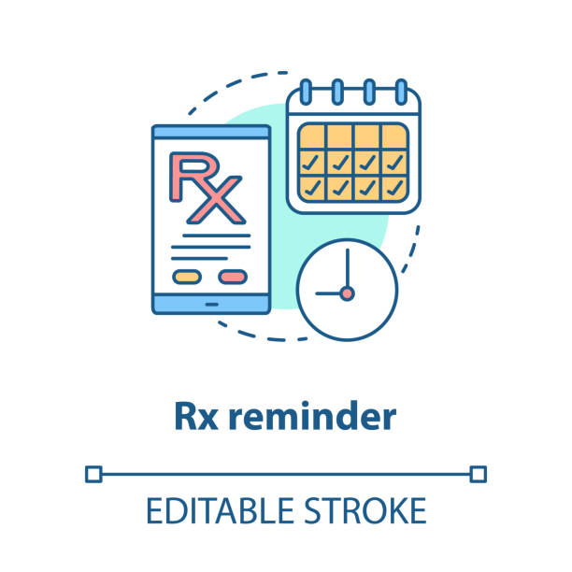


U-RX: Your Personalized Medication Reminder
Project by: Anas Almashhour
https://github.com/ksu-hmi/Remind_Rx-2.0

